Slide 1
Age Well Live Well
Bridges 2018
Notes:
Intro. Ice breaker.

Slide 2
Learning Objectives
Upon completion of this presentation session, participants will be able to:
Recall information about older adult demographics, needs, and emerging trends in the state of Texas
Review the Age Well Live Well (AWLW) campaign and aging initiatives from the office of Aging Service Coordination at Texas Health and Human Services (HHS)
Discuss and practice how to seek-out and create partnerships in the aging network
Notes:
Word for word, these are the learning objectives we identified for this education session.

Slide 3
Session Agenda
Overview of Texas aging demographics
Overview of the AWLW campaign, as well as specific program and initiatives from the office of Aging Service Coordination (ASC)
Discuss partnerships

Slide 4
Texas Health and Human Services
HHS oversees the operation of the health and human services system. HHS has responsibility for strategic leadership, administrative oversight of Texas health and human services system programs, and provides direct administration of some programs.
HHS oversees:
Eligibility Determination
System Planning and Evaluation
Policy Development and Rule-making
Ombudsman Services
Aging Programs

Slide 5
Aging Services Coordination
Support older Texans to Age and Live well by:
Connecting and coordinating aging services and programs
Raising awareness of aging issues and available resources
Creating innovative programs to meet needs
Building partnerships to enhance and expand existing resources

Slide 6
Texas Demographics
Second most populous and second largest state in the U.S.
Covers over 265,000 square miles
Population: 27+ million residents
Six Texas cities have populations greater than 500,000.
Austin, Fort Worth, and El Paso are among the top 25 largest U.S. cities.
17.6% of residents live below poverty level

Slide 7
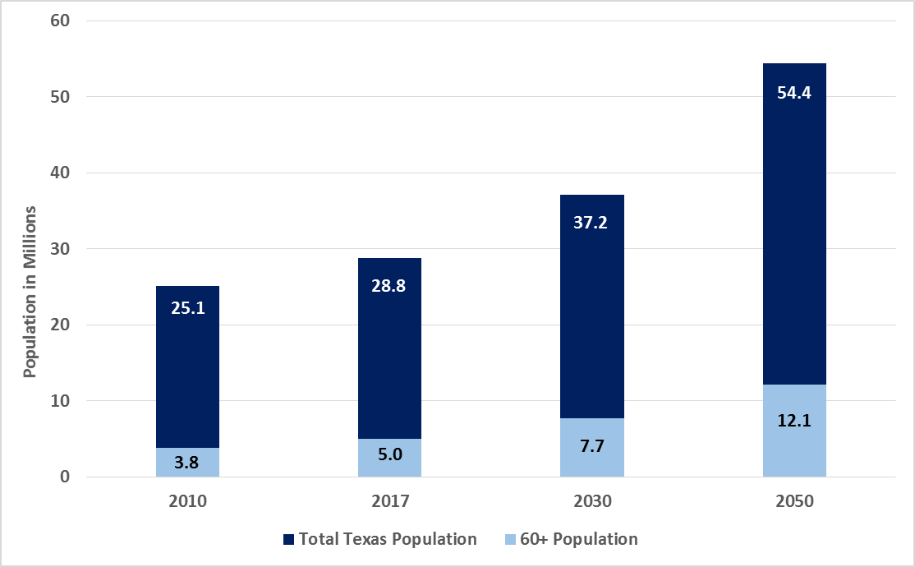
Total Texas Population and Population Age 60 or Older
Data Source: Population Projections 2010-2050. Texas Demographic Center.
Prepared by Center for Analytics and Decision Support
May 18, 2017
Notes:
2017 - 5M representing 18% of total population
2030 - 7.7M representing 21% of total population
2050 - 12.1M representing 22% of total population

Slide 8
Population Age 60 or Older
Boomers (1946-64) represented 5.6M
20% of Texans age 60 or older are 75-84
Projected increase to 26% by 2030
7% of people age 60 or older are age 85 or older
Projected increase to 13% by 2050
24% are Hispanic
Projected increase to 43% by 2050
A person that reaches age 65 can expect, on average, to live an additional 19 years
Notes:
2017 data unless otherwise noted
Like all states, Texas faces many challenges to providing services/supports for our older residents
Increased racial/ethnic diversity
Wider age gap between young and older groups
Increase in an older workforce
Rural isolation
Increased life expectancy
Wider economic disparities
Increase in divorces/people living alone
Increased rate of older adults needing nursing care
Increase of older adults with dementia
Increase in the financial impact on our Social Security and Medicare/Medicaid systems that are in place

Slide 9
Population Age 60 or Older
10% lived below the Federal Poverty Level (2015)
Social security most frequently cited source of income (2015)
Approximately 14% were enrolled in Medicaid
12% of all Texans lived with a disability
35% of those were age 60 or older (2015)
29% of Texans 60 or older are employed
56% are age 60-64 (2015)
Notes:
2015 FPL was $11,770 annual
AGE GROUP Age 60-64 764,965 54.1% 25,579 1.8% 623,426 44.1% 55.9% 1,413,970 Age 65 - 69 357,241 31.7% 12,512 1.1% 758,106 67.2% 32.8% 1,127,859 Age 70 - 74 143,080 17.8% 4,519 0.6% 657,756 81.7% 18.3% 805,355 Age 75 - 79 58,324 10.5% 1,663 0.3% 494,295 89.2% 10.8% 554,282 Age 80+ 30,424 4.2% 882 0.1% 700,981 95.7% 4.3% 732,287 TOTAL 60+ 1,354,034 29.2% 45,155 1.0% 3,234,564 69.8% 30.2% 4,633,753

Slide 10
Aging Texas Well
Established in 2005 by Executive Order RP 42, Aging Texas Well (ATW) identifies and discusses policy issues, guides state government readiness, and promotes increased community preparedness for an aging Texas population.
HHS issues the ATW plan every bi-annum with support from the ATW advisory committee.
Notes:
Note Aging Texas Well Plan (not currently in slides).

Slide 11
Aging Texas Well Advisory Committee
ATW Advisory Committee advises Texas HHS and makes recommendations to state leadership on:
Implementation of the Aging Texas Well Initiative
The state’s readiness to meet needs and methods for preparedness.
The ATWAC provides recommendations through quarterly meetings, issue briefs, public testimony, and ad hoc.
Currently the ATWAC is implementing its charge in SB1693 to research independent living services for older Texans experiencing vision loss.

Slide 12
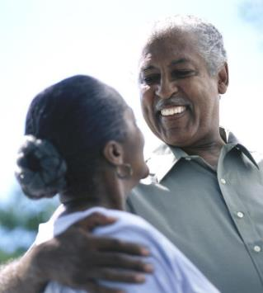
Age Well Live Well
In 2050, Texans aged 65 and over is projected to be 17.4 percent.
The Age Well Live Well campaign provides resources and tools to help individuals and local communities address the challenges associated with aging and create opportunities for living well.
Notes:
Provide a quick overview for Aging Texas Well and how AWLW relates to this…
The Aging Texas Well Plan was mandated by an Executive Order (RP 42) back in 2005 and covers 16 life areas critical to aging well.
[16 areas are: Caregiving, Community support, Education, Employment, Financial, Health and long-term care, Housing, Legal, Mental health, Physical health, Protections, Recreation, Social engagement, Spirituality, Transportation and Volunteerism]
The ATW Plan is a comprehensive and effective strategy to identify and discuss aging policy issues, guide state government readiness and promote increased community preparedness for an aging Texas. With guidance from the Aging Texas Well Advisory Committee, HHSC updates the plan every two years.
Age Well Live Well is a campaign that creates an accessible way to engage with healthy behaviors as we all age.
Today’s we’ll be highlighting many of the programs and resources that are bundled under this healthy aging initiative.

Slide 13
Age Well Live Well
The Age Well Live Well campaign provides resources, tips, tools and expertise to help Texans:
Be Healthy: By improving the physical health of older adults, their families and the community at large.
Be Connected: By providing opportunities for Texans to get engaged in local activities and volunteer.
Be Informed: By creating awareness of aging-related issues and resources offered through Age Well Live Well partners, HHS and the aging and disability network.
Notes:
The three focus areas of the AWLW are: Be healthy, Be connected and Be informed.
For be healthy: We offer resources and programs about physical activity and nutrition.
For be connected: We promote the importance of staying connected and engaged with your community as a key component of living a healthy lifestyle. To support this we provide information on how to volunteer and resources for volunteer managers.
For be informed: We assist with information awareness across the state by helping to establishing connections with existing programs and resources.

Slide 14
Notes:
So let’s think for a minute about each of your facilities and the overall healthy outlook for both staff and residents.
Can I get some examples of what is available at your facility for activities that are specific to physical activity, exercise, movement, etc.?
Can I get a show of hands for how many people here have heard of Texercise?
What about the number of you who are using Texercise in some way with your facility?
Ask audience members to share how they are using Texercise.

Slide 15
Be Healthy
Outcome of inactivity
In 2013, 38 percent of Texans 65 and older were overweight and 27.6 percent were obese.
By 2030 the Texas adult obesity rate will reach 57.2 percent.
Benefits of activity
Preventable illness makes up approximately 80% of the burden of illness and 90% of all healthcare costs.
People who participate in physical activity on a regular basis lower their risk of developing a chronic disease by 30–50%.
Notes:
Here, we can compare some of the outcomes for inactivity with the benefits of physical activity.

Slide 16
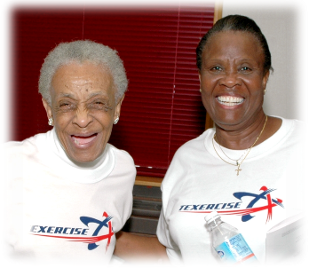
Be Healthy: Texercise
Texercise
A statewide health promotions initiative of HHS, educates and involves individuals and communities in physical activities and proper nutrition.
Notes:
Texercise has been around for 20 years and is now officially an evidenced-based health promotions program.
Texercise is flexible and there are multiple ways to get involved.
For example, you may wish to serve as a certified facilitator by completing the new Texercise Select program and conduct the activities with residents and staff in your facility; or
You may wish to start smaller and choose the Texercise Classic model to begin, which has less requirements and is not a certified model.
Texercise provides Take Charge Challenge Sheets that you can use to set your goals, which should be SMART goals (specific, measurable, attainable/achievable realistic and timely).
Texercise also provides Daily Physical Activity Logs to help keep you on track with your goals.
There are multiple ways for recognition available for your Texercise program participants such as having an Exercise Party or an awards ceremony to distribute the free program incentives (available by partners who provide T-shirts, water bottles, etc.) for achieving healthy goals.

Slide 17
Be Healthy: Texercise
Texercise provides tools and resources to assist with making healthy lifestyle changes such as:
Educational resources to help create understanding of the importance of a healthy diet and regular physical activity;
Motivational resources to encourage participation and adoption of healthy habits; and
Recognition resources to formally recognize the efforts of participants.

Slide 18
Be Healthy: Texercise
Texercise free resources include:
Handbook
Fact Sheets
12 fitness
8 nutrition
Texercise Classic
Texercise Select
Website (www.Texercise.com)
Notes:
Here’s a quick list of the free resources available for participants following the Texercise requirements.

Slide 19
Be Healthy: Texercise
Texercise statewide partners:
Parks and recreation departments (community and senior centers)
Long-term care facilities
Faith-based organizations
Non-profits in the field(s) of health and aging
City and county governments
Notes:
Detail a variety of collaborations (this is meant to show how we created partnerships, helping us in part 2 of presentations):
Houston PARD, TRAPS, Tyler videos, Walk with a Doc, Cigna, Faith based, etc.

Slide 20
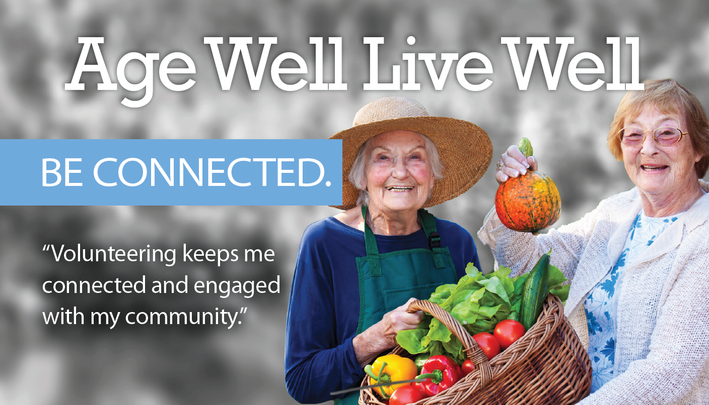
Notes:
Our second focus area under the AWLW initiative is BE CONNECTED.
Community involvement can help reduce many of the effects of loneliness and social isolation.
Staying connected and engaging with your community is a key component of living a healthy lifestyle. To support this areas of AWLW. we provide information on how to volunteer and resources for volunteer managers.
How many of you have active volunteer programs at your facilities that help with person-centered activities and quality of life for your residents and staff?
Camden: With a new emphasis on person-centered care and quality of life, providers need to be informed to make more strategic connections between volunteerism and unique opportunities for social interaction and meaningful, person-centered activities.
We just started a three-year CMP grant project with 10 nursing facilities who are evaluating their current volunteer management system and quality of life opportunities for both residents and staff.
I’ll be working with each of these facilities for three years and tracking how quality of life may or may not change through more targeted efforts to connect through volunteerism.

Slide 21
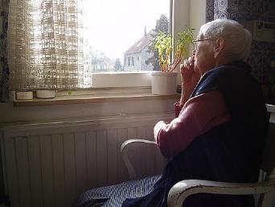
Be Connected
Importance of staying engaged
16% of adults 65 and older report feeling lonely and 12% isolated.
Older adults that report loneliness are:
More likely to report limitations in their ability to conduct everyday activities; and
More likely to engage in weekly social activities
Notes:
Let’s look at a few recent statistics on loneliness and isolation involving older adults.
The good news is that community involvement can help reduce many of the effects of loneliness.
Source:
First bullet: Social Care Institute for Excellence: http://www.scie.org.uk/publications/ataglance/ataglance60.asp
Second bullet: http://connect2affect.org/wp-content/uploads/2017/02/A-Profile-of-Social-Connectedness.pdf

Slide 22
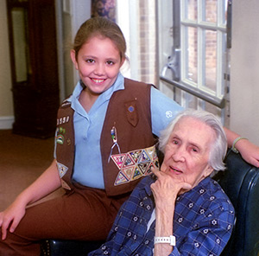
Be Connected: Silver Lining
Silver Lining is a partnership between the Texas Health and Human Services Commission (HHSC) and the Girl Scout councils in Texas.
Girl Scout troops are connected with a nursing home or assisted living facility in their area.
Notes:
Discuss girl scouts and boy scouts. Discuss efforts with Boy Scouts in terms of partnership creation.

Slide 23
Be Connected: Innovators in Aging
Award highlighting and recognizing unique and effective efforts impacting older adults.
Individuals, programs, organizations, communities, and technologies are encouraged to apply.
Nominations are open from May – November 2018.
Award winners will work with HHS in Spring 2019 to highlight their program.
HHS will disseminate information about winners in May 2019
Apply at hhs.texas.gov/innovators-aging

Slide 24
Be Connected: CMP Funds
A research project that will provide practical guidance to nursing facilities on how to recruit and retain volunteers and develop volunteer programming.
With robust volunteer support in these more at-risk facilities, both the residents’ quality of care and staff job satisfaction would improve.

Slide 25
Be Connected: VISTA
In 2018, 8 VISTAs will begin working on projects to support the AWLW campaign statewide. VISTAs will support AWLW by developing awareness and infrastructures for older adults at local levels. The VISTA’s are located:
Area Agency on Aging of the Capital Area (Austin)
Area Agency on Aging of Deep East Texas (Tyler)
Area Agency on Aging of East Texas (Kilgore)
Harris County Area Agency on Aging (Houston)
Area Agency on Aging of the Lower Rio Grande Valley (McAllen)
North Central Texas Area Agency on Aging (Denton)
Area Agency on Aging of West Central Texas (Abilene)
Notes:
Also note vista in ASC office.
Also note the type of things we’re hoping vistas do.
Also note, if you live in one of these areas, perhaps plan on working with an ASC VISTA in the future.

Slide 26
Notes:
Our third focus area involves information awareness.
I’d like you to think about:
how informed you are as an individual;
how informed your family and friends are; and
how the residents you work with are as to what is available in the aging and disability network both in Texas and the U.S.

Slide 27
Be Informed: Fact Sheets
Facts sheets and posters on a variety of topics including:
Supports and services for older adults
How to volunteer with older adults
Respite care
Physical exercise and nutrition
Notes:
***ASC has created state-wide partnerships with several organizations who print and distribute fact sheets and poster cards in May for Older American’s Month.

Slide 28
Be Informed: Media Outreach
ASC produces materials each month for the public on aging issues.
Disseminate monthly articles and ads on aging issues and topics throughout the state
To obtain the articles and/or ads from ASC, email AgeWellLiveWell@hhsc.state.tx.us
Notes:
This

Slide 29
Be Informed: Outreach
ASC actively shares information about AWLW campaign with public, private, non-profit, and faith-based organizations, encouraging them to participate as able.
ASC also provides outreach to a variety of professions and organizations to discuss needs and issues with older adults, including:
Pharmacists
First Responders
Faith-based organizations

Slide 30
Be Informed: Texas Talks
Texas Talks is a workplace campaign that encourages working adults to talk (and prepare) with older adult family members and friends for the aging process.
70% of families are having their first conversation about aging needs and issues after an emergency!
Notes:
Talk about why of partnership and reaching out to Corporate partners…response back.

Slide 31
Be Informed: Texas Talks
Organizations wanting to participate in Texas Talks must:
Download the corporate toolkit
Email out the four template emails to employees and volunteers in the months of November and December
Emails discuss the topics of:
Storing personal information
Physical health
Socialization
Caregiving
Emails also discuss how to talk about aging in a productive, empathetic way
Notes:
Talk about why of partnership and reaching out to Corporate partners…response back.

Slide 32
Be Informed: AWLW Toolkit
The Age Well Live Well (AWLW) Creating, Enhancing and Sustaining Community Collaboratives Toolkit was developed to help AWLW collaboratives and local partners create, expand and grow their AWLW activities and programs.
Resources and tools are offered in the following categories:
Planning
Awareness
Partners
Sustainability
Many of the tools provided in this toolkit can be tailored to address specific audiences or compliment the local resources.

Slide 33
Stretch Break

Slide 34
Partners
With limited state and federal resources dedicated to programs, HHS relies on community partnerships to enhance public awareness, outreach and funding of services.
At the community level, partnerships help to eliminate duplication and fragmentation in community outreach and programs.
They also provide consumers with more choices and opportunities for receiving critical information, resources and services.

Slide 35
Partners
Partner — all entities (public, private, nonprofit or faith-based) that join with HHS to achieve a commonly desired result.
Partnership — The process of working with another organization in an equally advantageous relationship to reach an identified goal.

Slide 36
AWLW Partners
Parks and Recreation
City leadership
Service providers
Community homes
Nonprofits
Civic groups
Corporate
Faith-based
Medical
Media
HHS local offices
Area Agency on Aging
Aging Disability Resource Center
Academic
Advocacy and volunteer groups

Slide 37
Types of Partners
Funding – partners that provide direct monetary funding to support efforts.
In-kind – partners that provide goods, services, commodities and/or supports to meet identified goals.
Volunteer – partners that provide volunteer backing and/or volunteer opportunities to support programs and services.
Media – partners that provide print and online coordination of local media, including brochures, flyers, radio, television, etc.
Planning – partners that chair or coordinate planning of local community programs, coordinate volunteer efforts, and/or awareness and event support.
Project — partners that can provide support on short-term project or activity to achieve identified goals within a specified time frame.
Strategic — partners that can provide long-term commitments on a committee, project or activity.
Notes:
Discuss collaboratives.

Slide 38
How to Build Partnerships
Identify a common thread(s) to build off
Identify mutual goals
Identify easy and immediate wins
Be direct when discussing details
The relationship is a priority
Be generous when discussing what you bring to the partnership; and circle back to YOU

Slide 39
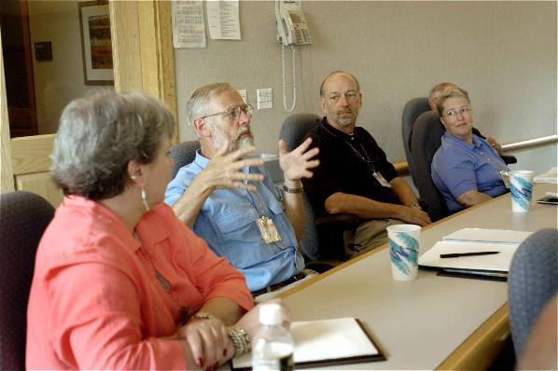
AWLW Challenge: Group Activity
Now, it’s your turn!

Slide 40
Activity: Creating Partnerships
Small group brainstorming
Use this list to help guide discussion:
Introduce yourself and your organization, including
How your organization recruits new consumers
How your organization works with volunteers
Community engagement projects your organization works on
Plan an “engagement” opportunity
Identify common thread(s) to build off
Identify mutual goals
Identify easy and immediate wins
Report back to session

Slide 41
Age Well Live Well Challenge
Be Healthy. Be Connected. Be informed.
Think about one change you can make for yourself
Think about one change you and/or your organization can make.
Challenge yourself to find a new “partner” at this conference!
Notes:
You can create involvement on any level.
On an individual level, you can start assessing and creating your own healthy changes.
Today, we’re going to take this idea one step further and look at how to affect change in the facility, benefitting your residents and the staff.

Slide 42
Contact Information
Texas Health and Human Services
Aging Service Coordination
1-800-889-8595
Holly Riley: Holly.Riley@hhsc.state.tx.us
Will Armstrong: Will.Armstrong@hhsc.state.tx.us
Notes:
The most important thing to remember is that there are many opportunities to engage and bring about positive, healthy changes.
Thank you for your time and participation today.
Please contact us to talk more about your ideas and goals. There may be active community groups who can assist you, for example.
Please fill out the evaluation for this session before you leave and enjoy the rest of your meeting activities.

